Slide 1


Government of the People's Republic of Bangladesh
Ministry of Commerce · BRCP-1 [Part-2]
Government of the People's Republic of Bangladesh
Ministry of Commerce · Bangladesh Regional Connectivity Project-1 [Part-2]
PROJECT
WENP — New Features Development
CONTRACT PACKAGE
SD-56 · RFP 26.00.0000.066.07.068.26
IMPLEMENTING AGENCY
Ministry of Commerce
Government of the People's Republic of Bangladesh
PROJECT DIRECTOR
Shaila Yasmin · Additional Charge, PIU Focal Point
PROJECT DIRECTOR
Shaila Yasmin · Additional Charge, PIU Focal Point
LEAD EXECUTING AGENCIES
BLPA · NBR · WENP under MoC stewardship
Package SD-56 · Contract Reference IBCS-PRIMAX/WENP/SD-56/2026/01
Inception Report
New Features Development of the Women Entrepreneurs Networking Platform (WENP)
Submitted To
Project Director
BRCP-1 [Part-2], Ministry of Commerce
Date of Issue
September 2026
Project ID
P154580
IDA Credit No. 6022-BD

Slide 2
Government of the People's Republic of Bangladesh
Ministry of Commerce · BRCP-1 [Part-2]
Inception Report Acceptance Meeting
Meeting Purpose
Formal Inception Report Presentation & Acceptance Meeting
Platform
Women Entrepreneurs Networking Platform (WENP)
Implementing Agency
Bangladesh Regional Connectivity Project-1 (BRCP-1)
Ministry of Commerce
Government of the People's Republic of Bangladesh
Chairperson
Shaila Yasmin — Joint Secretary & Project Director (Additional Charge), BRCP-1, Ministry of Commerce
Consulting Firm
IBCS-PRIMAX Software (Bangladesh) Ltd.
Contract Package No. SD-56 · IDA Credit No. 6022-BD
Consultant Credentials
IBCS-PRIMAX Software (Bangladesh) Ltd.
CMMI Level 3 appraised · ISO 9001:2015 · ISO 27001 certified
35+ years of enterprise software engineering experience in Bangladesh
28 experts mobilised — 16 Key and 12 Non-Key · 57.0 person-months
Official Endorsements
Government of the People's Republic of Bangladesh — Ministry of Commerce
World Bank / IDA — Credit No. 6022-BD, Project ID P154580
WENP project identity under MoC stewardship

Slide 3
Government of the People's Republic of Bangladesh
Ministry of Commerce · BRCP-1 [Part-2]
Background of the Project
National Trade Registry
An essential digital platform developed under the Ministry of Commerce to support female economic participation across Bangladesh.
National Trade Registry
32,000+
Verified women entrepreneurs registered nationwide
64
Districts covered across Bangladesh
BTP 3.0
Shared server environment with the Bangladesh Trade Portal — WENP's technological evolution aligns directly to BTP Version 3.0 standards
Active User Base
Successfully established a digital network connecting over 32,000 verified women entrepreneurs nationwide across all 64 districts.
Shared Infrastructure
Hosted on the same server environment as the Bangladesh Trade Portal (BTP); its technological evolution directly aligns with BTP Version 3.0 standards.
Strategic Evolution
Transitioning from a static networking directory into an interactive, transactional and compliant trade facilitation ecosystem.

Slide 4
Government of the People's Republic of Bangladesh
Ministry of Commerce · BRCP-1 [Part-2]
Existing WENP Features at a Glance
01
Directory Search & Discovery
Enables visitors to search basic registered women entrepreneurs by name, district or product category.
02
Member Registration
Online registration form allowing women entrepreneurs to submit their personal and business details.
03
Static Profile View
Basic profile display showing contact information, category of business and uploaded static photographs.
04
Web-Only Access
Desktop-oriented web browsing interface accessible via standard web browsers only.
05
Basic Information Resources
Static informational pages detailing government notices and basic trade support materials.
06
Manual Profile Moderation
Back-office administrative interface where submitted entrepreneur profiles are manually reviewed before publishing.
07
Basic Contact Messaging
Standard contact form allowing users to submit unstructured messages or queries to platform administrators.
08
Single Language Interface
Predominantly English-oriented user interface, presenting significant barriers for rural and micro entrepreneurs.

Slide 5
Government of the People's Republic of Bangladesh
Ministry of Commerce · BRCP-1 [Part-2]
Diagnostic Gap Analysis
Complex & Non-Intuitive UI
Cluttered user journey that lacks modern micro-interactions and intuitive mobile layouts.
Absence of Virtual Marketplace
No integrated capability to display product inventories, process customer orders or manage transactions.
Lack of Mobile-First Experience
Poor responsiveness on low-end smartphones, with no native Android or iOS application support.
Zero Micro-Accounting Support
No digital bookkeeping, expense tracking, invoice generation or Return on Investment (ROI) analytics.
Language Barrier
Absence of a comprehensive Bangla-first localized interface, excluding non-English speaking micro-entrepreneurs.
Lack of External Integrations
Completely decoupled from national identity verification (DBID / NID), automated SMS gateways and secure MFS / payment switches.
Inefficient Search Architecture
Lack of real-time search indexing, auto-suggestions and multi-facet filtering (by pricing, rating, location).

Slide 6
Government of the People's Republic of Bangladesh
Ministry of Commerce · BRCP-1 [Part-2]
The New WENP Platform Vision (WENP 3.0)
01
Comprehensive Trade & Commerce Hub
Transforming WENP into a transactional marketplace and commercial enablement engine.
02
Bangla-First & Mobile-First
Built from the ground up to ensure low-bandwidth performance (LCP < 2.5s on rural 3G) and full accessibility (WCAG 2.2 AA).
03
Native Mobile Apps
Developing high-performance cross-platform mobile apps for Android and iOS via Flutter..
04
Automated Trust & Verification
Streamlined profile approval integrated with national digital verification (DBID / NID).

Slide 7
Government of the People's Republic of Bangladesh
Ministry of Commerce · BRCP-1 [Part-2]
Upgraded Management
Dashboard
Tri-Tier Role-Based Dashboards
Tailored real-time dashboards for Administrators, Women Entrepreneurs and Customers.
Grievance
End-to-End Grievance Redressal
Digital complaint management tracking registration, inquiry, resolution and user closure notifications.
Reporting
Enterprise Reporting
Live operational metrics, order fulfillment analytics and automated compliance auditing.

Slide 8
Government of the People's Republic of Bangladesh
Ministry of Commerce · BRCP-1 [Part-2]
WENP Core Functional Modules Matrix
M01
Identity & Authentication
JWT, SMS OTP, secure password recovery and optional 2FA.
M02
Automated Profile Approval
Algorithmic validation with manual review fallbacks and DBID / NID integration.
M03
Virtual Marketplace
Dynamic product showcases, digital ordering and categorized vendor listings.
M04
Micro-Accounting & Bookkeeping
Ledger management, invoice issuance, revenue tracking, cash-flow reporting.
M05
Smart Search & Discovery
Multi-faceted keyword search, geolocation filters and auto-complete indexing.
M06
Omnichannel Communication
Real-time push alerts, SMS notifications, email updates and in-app chat.
M07
Review, Rating & Trust
Verified buyer feedback, star ratings and transparent entrepreneur credentials.

Slide 9
Government of the People's Republic of Bangladesh
Ministry of Commerce · BRCP-1 [Part-2]
WENP Key System Attributes
Attribute 01 · Resilience
Degrade, Never Fail
Resilient decoupled architecture with automatic fallback mechanisms — offline sync for mobile apps and SMS fallbacks for push notifications.
Attribute 02 · Security
Security & Privacy by Design
TLS encryption, field-level encryption for sensitive NID / financial data, WAF deployment and zero OWASP Top-10 vulnerabilities.
Attribute 03 · Performance
Low-Bandwidth Optimization
Code splitting, lazy loading of imagery, Redis caching and edge CDN integration — engineered for rural 3G conditions.
Attribute 04 · Cost of Ownership
Zero Commercial Licensing Liabilities
Built entirely on production-grade open-source technology frameworks to eliminate post-handover license costs for the Ministry.

Slide 10








Government of the People's Republic of Bangladesh
Ministry of Commerce · BRCP-1 [Part-2]
Technology Stack & Tooling
Layer 01
Backend Framework
PHP 8.2+ with Laravel 10 — clean Service Layer architecture, PSR-12 coding standard.
Layer 02
Frontend Web
HTML5, CSS3, Bootstrap 5, JavaScript / jQuery and the Blade templating engine.
Layer 03
Mobile Applications
Flutter framework for cross-platform compilation to native Android and iOS.
Layer 04
Database & Caching
MySQL 8.0 Enterprise relational database with Redis for high-speed session management and caching.
Layer 05
CI/CD & Source Code
GitHub Enterprise, Jenkins / GitHub Actions — mirrored to the National Code Repository (NCR — GitLab).
Layer 06
Infrastructure & Cloud
Hosted at National Data Center (NDC) / BDCCL on secure Linux (CentOS / RHEL) with WAF protection.

Slide 11








Government of the People's Republic of Bangladesh
Ministry of Commerce · BRCP-1 [Part-2]
Quality Assurance & Testing Strategy
Our QA strategy ensures that every requirement is tested, with a clear entry and exit criterion for each phase. The work encompasses the eight (8) specified test types mandated by the TOR.
The project encompasses a formal V-Model approach with eight specified test types:
Unit Testing
Integration Testing
System Testing
Performance/Load Testing
100% coverage on critical business logic.
API contracts and database interactions.
End-to-end web and mobile testing against the SRS.
Verify the strict performance budget (e.g., LCP < 2.5s).
Security Testing
Functionality Testing
User Acceptance Testing (UAT)
BCC SQTC Testing
SAST, DAST, and an independent VAPT by a third-party expert.
Requirement-by-requirement verification via traceability matrix.
Real-world testing with 8-12 entrepreneurs across ≥4 districts.
Full support provided for testing at the BCC Software Quality Testing Centre.

Slide 12
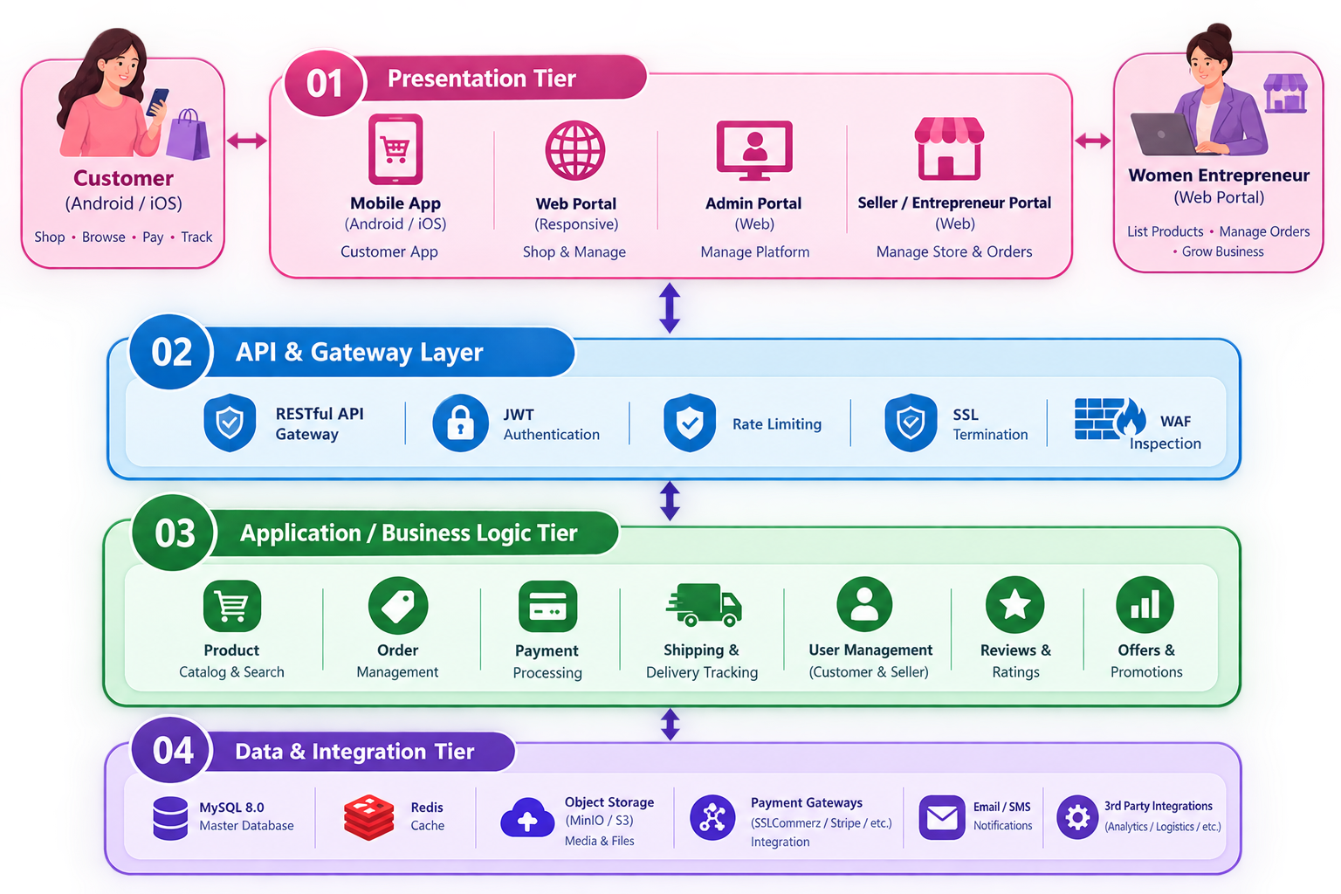
Government of the People's Republic of Bangladesh
Ministry of Commerce · BRCP-1 [Part-2]
Multi-Tier Architectural Framework

Slide 13
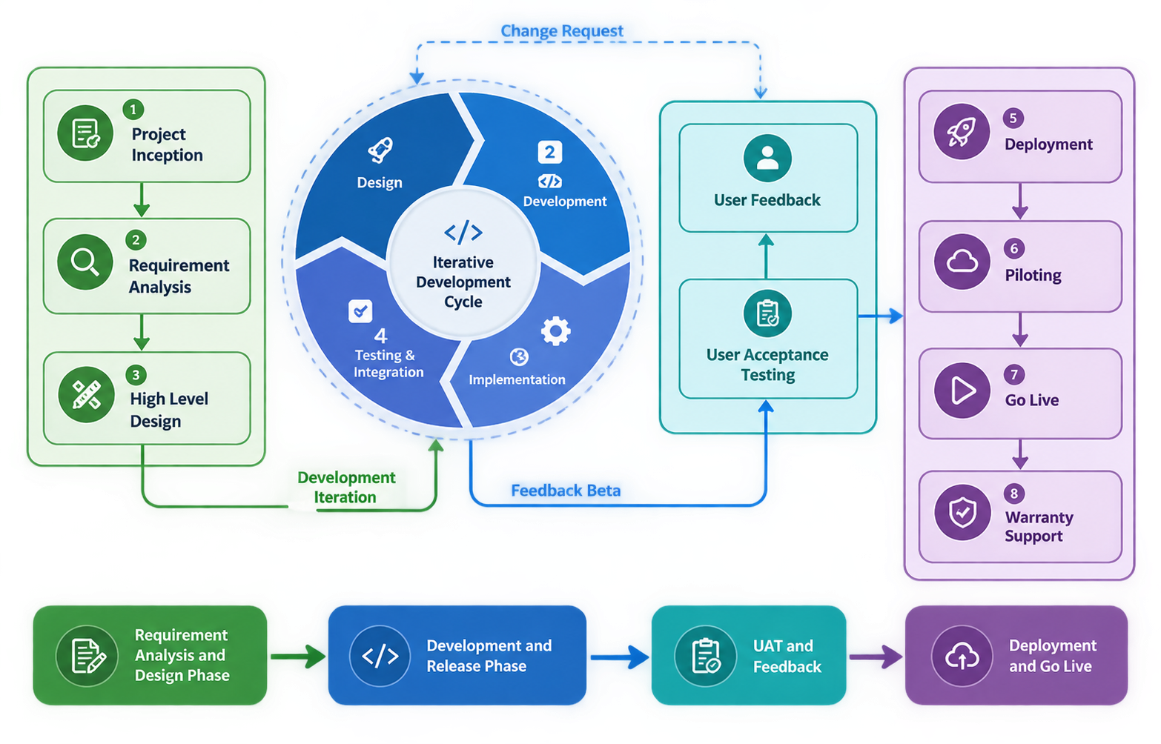
Government of the People's Republic of Bangladesh
Ministry of Commerce · BRCP-1 [Part-2]
Software Development Life Cycle (SDLC) Methodology

Slide 14
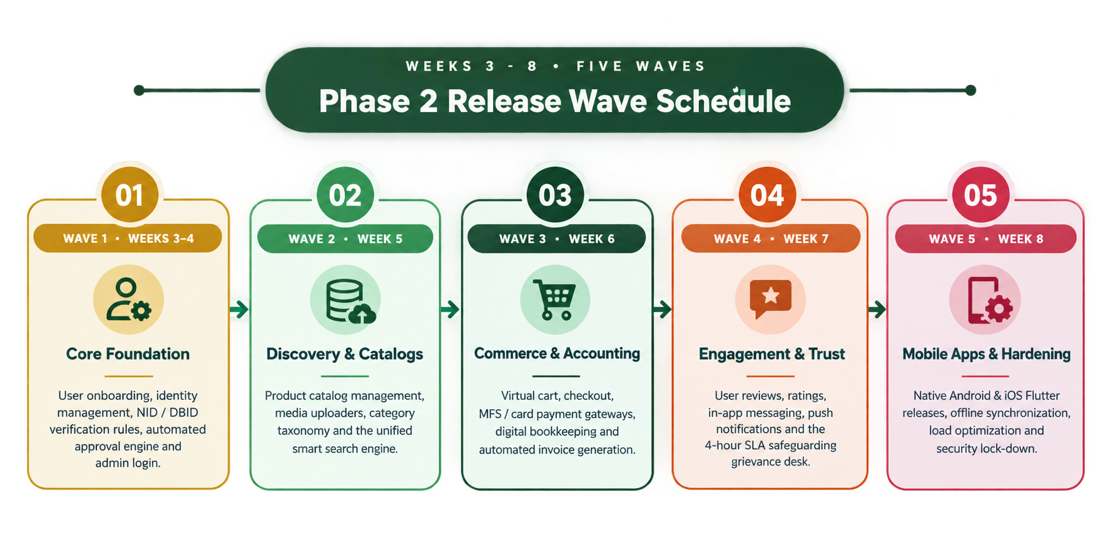
Government of the People's Republic of Bangladesh
Ministry of Commerce · BRCP-1 [Part-2]

Slide 15
Government of the People's Republic of Bangladesh
Ministry of Commerce · BRCP-1 [Part-2]
Detailed Project Timeline 01
SL | Activity | W1 | W2 | W3 | W4 | W5 | W6 | W7 | W8 | W9 | W10 | W11 | W12
1 | PHASE 1: RESEARCH & DESIGN (2 Weeks)
2 | Kick-off & Inception
3 | PIU Focal Point Nomination
4 | Environment Setup
5 | Review of Existing Platform
6 | User Research (≥4 Districts)
7 | Comparison Report
8 | Wireframes & Prototype
9 | Advisory Board Validation
10 | Migration Rule Set & Mapping
11 | SRS Drafting & Finalization
12 | SRS Acceptance Workshop
13 | GATE G1: SRS Approved |  |  | ◆

Slide 16
Government of the People's Republic of Bangladesh
Ministry of Commerce · BRCP-1 [Part-2]
Detailed Project Timeline 02
SL | Activity | W1 | W2 | W3 | W4 | W5 | W6 | W7 | W8 | W9 | W10 | W11 | W12
15 | Wave 1: Foundation (Weeks 3-4)
16 | M01: Identity, Registration & Auth
17 | M02: Profile & Auto Approval
18 | M17: Audit & M18: Admin
19 | Migration Dry Run 1
20 | Wave 1 Demo to PIU
21 | Wave 2: Discovery (Weeks 4-5)
22 | M 03: Virtual Marketplace
23 | M 04: Product Catalogue & Media
24 | M 05: Search & M14: CMS
25 | Migration Dry Run 2
26 | Wave 2 Demo to PIU
27 | Wave 3: Commerce (Weeks 5-6)
28 | M 06: Order & Fulfillment
29 | M 07: Payments & MFS
30 | M 08: Accounting
31 | Wave 3 Demo to PIU

Slide 17
Government of the People's Republic of Bangladesh
Ministry of Commerce · BRCP-1 [Part-2]
Detailed Project Timeline 03
SL | Activity | W1 | W2 | W3 | W4 | W5 | W6 | W7 | W8 | W9 | W10 | W11 | W12
33 | M09: Dashboards
34 | M10: Messaging & Notifications
35 | M11: Reviews & M12: Complaints
36 | M13: Learning & M15: Reporting
37 | M16: Trust & Safety
38 | Wave 4 Demo to PIU
39 | Wave 5: Mobile & Hardening (Weeks 7-8)
40 | Flutter Android & iOS Apps
41 | Offline Sync & Push Notifications
42 | Performance Tuning
43 | Migration Dry Run 3
44 | Wave 5 Demo to PIU
45 | GATE G2: Design Docs Signed |  |  |  |  |  |  |  |  | ◆

Slide 18
Government of the People's Republic of Bangladesh
Ministry of Commerce · BRCP-1 [Part-2]
Detailed Project Timeline 04
SL | Activity | W1 | W2 | W3 | W4 | W5 | W6 | W7 | W8 | W9 | W10 | W11 | W12
47 | System & Functional Testing
48 | Performance & Load Testing
49 | Security Testing (SAST/DAST)
50 | Independent VAPT
51 | UAT (≥4 Districts)
52 | BCC SQTC Testing
53 | GATE G3: UAT Sign-Off |  |  |  |  |  |  |  |  |  |  | ◆

Slide 19
Government of the People's Republic of Bangladesh
Ministry of Commerce · BRCP-1 [Part-2]
Detailed Project Timeline 05
SL | Activity | W1 | W2 | W3 | W4 | W5 | W6 | W7 | W8 | W9 | W10 | W11 | W12
55 | Defect Closure (Medium/Low)
56 | Documentation Finalization
57 | Migration Dry Run 4
58 | Source Code Handover to NCR
59 | Repository Ownership Transfer
60 | GATE G4: Handover Accepted |  |  |  |  |  |  |  |  |  |  |  | ◆

Slide 20
Government of the People's Republic of Bangladesh
Ministry of Commerce · BRCP-1 [Part-2]
Detailed Project Timeline 06
SL | Activity | W1 | W2 | W3 | W4 | W5 | W6 | W7 | W8 | W9 | W10 | W11 | W12
62 | Pre-Cut-over Communication
63 | Production Cut-over
64 | Mobile App Store Submission
65 | Hypercare Support
66 | 3-Day Operational Training
67 | 5-Day Technical Training
68 | Launching Ceremony
69 | GATE G5: NOC Issued |  |  |  |  |  |  |  |  |  |  |  | ◆

Slide 21
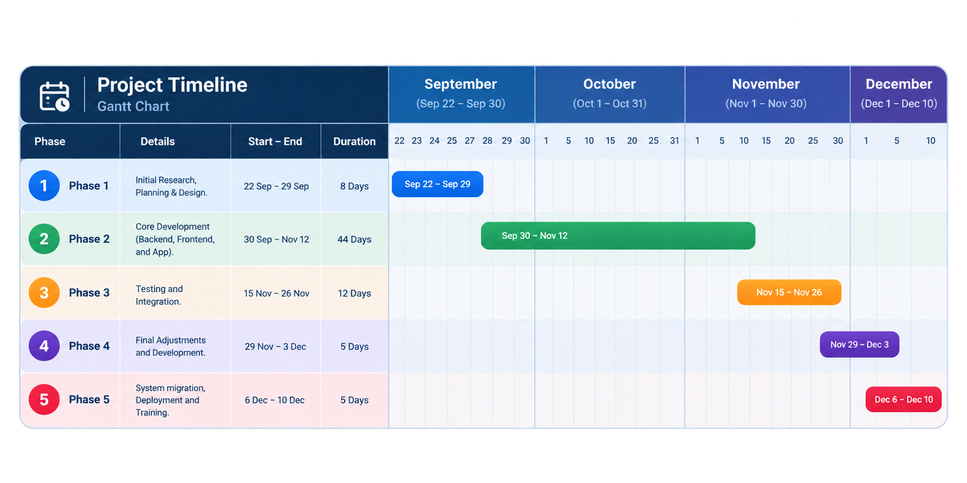
Government of the People's Republic of Bangladesh
Ministry of Commerce · BRCP-1 [Part-2]
Project Timeline Summary

Slide 22
Government of the People's Republic of Bangladesh
Ministry of Commerce · BRCP-1 [Part-2]
Five cadences. One transparent framework.
A formal reporting framework is essential for transparency and accountability. From internal stand-ups to formal Gate submissions — every tier of the project has a defined cadence.
Daily
EVERY WORKDAY
Internal Scrum stand-up meetings
15-minute status from every team member — blockers, yesterday, today. Internal cadence only.
AUDIENCE
Consultant's Core Team
Fortnightly
EVERY 2 WEEKS
Fortnightly Progress Report to PIU Focal Point
Formal written report — sprint outcomes, schedule vs. actual, financial status, risk updates.
AUDIENCE
PIU Focal Point
Monthly
EVERY MONTH
Comprehensive Monthly Progress Report
Full project health review — scope, timeline, budget, risk register refresh, and forward commitments.
AUDIENCE
Project Director
At Gates
G1 – G5
Formal Gate submission for Client review & acceptance
Each phase culminates in a formal sign-off point — SRS, Design Doc, Test Reports, etc.
AUDIENCE
Project Director & Imp Team
Ad-hoc
AS REQUIRED
Immediate written notification of major issues
Any major issue, escalating risk, or potential delay — flagged in writing to the PD within 24 hours.
AUDIENCE
Project Director

Slide 23
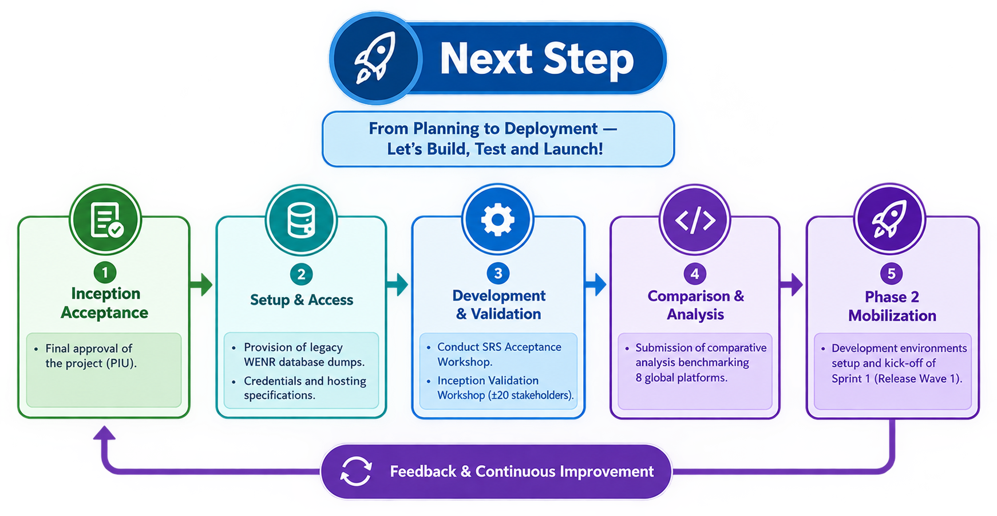
Government of the People's Republic of Bangladesh
Ministry of Commerce · BRCP-1 [Part-2]

Slide 24


